Slide 1
Pandemic PUBLIC TRANSIT GUIDANCE
DONE BY :
TEAM NAME : GOAL DIGGERS
G.GEFFAINA GERALDINE
R.EBENEZR
C.VIBIN ROY
ST.JOSPEH’S INSTITUTE OF TECHNOLOGY

Slide 2
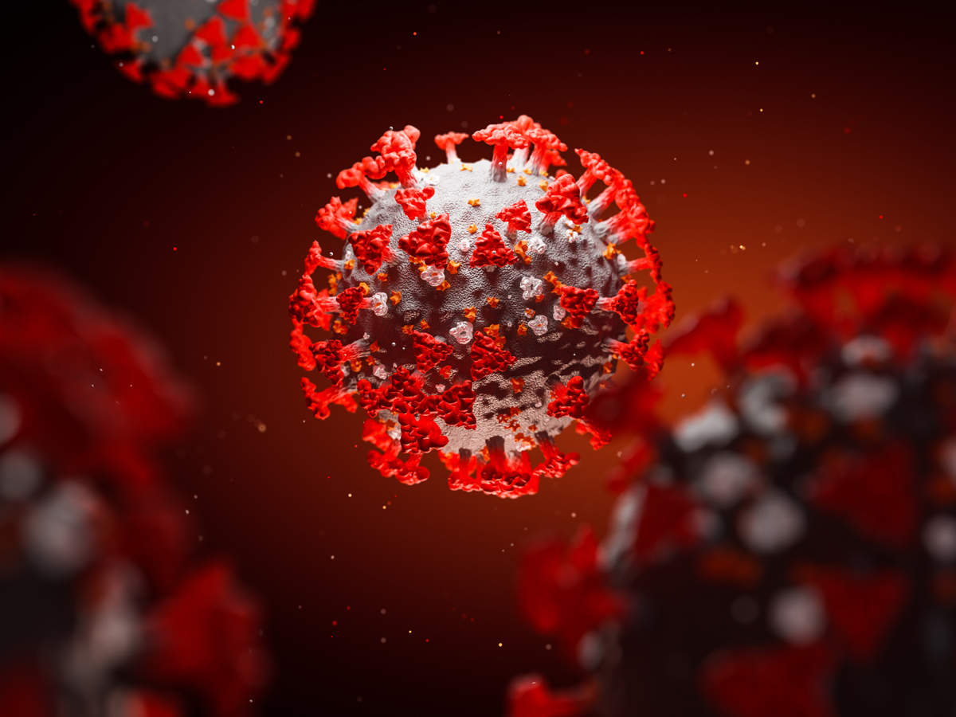
INTRODUCTION
The outbreak of coronavirus disease (COVID-19) has created a global impact on the way we perceive our world and our everyday lives. Travelling has been cutoff for more than 2 months which had a huge negative impact on the fields which are related to transportation .”SOCIAL DISTANCING “ and “CONTACTLESS PAYMENT “ are the major factor to be considered during travelling and the following solution greatly improves these two factors

Slide 3



TECHNOLOGY USED
PYTHON 3
IBM CLOUD PLATFORM
ANDROID DEVELOPMENT FRAMEWORK
BLUE PRISM (ROBOTIC.PROCESS.AUTOMATION.)
EXCEL

Slide 4


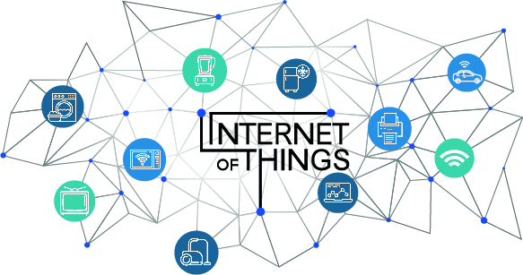
SOLUTION
Initially the process starts with the bus conductor .When a passenger boards the bus he/she has to scan the QR code (DIGITAL PASS) after verification the count is determined and then the count should be subtracted with people who get down , by the power of IOT data is transmitted to the cloud after manipulation. Data is available in json format which is fetched and displayed in the android app. Final app displays the location of the bus and count present

Slide 5


solution
In order to inform the user about the validity of the digital pass .The username and user mail id is stored in excel sheet .By the power of RPA a software bot is designed which will validate the date of purchase to the present date if the validity of the pass is about to expire it will send a short message to the user informing them about validity of the digital pass

